Slide 1
SPEF Extractor
By: Hany Moussa,
Ramez Moussa,
Samah Hussein and
Mohammed Mahfouz

Slide 2
Problem Definition
We are required to extract the SPEF file with the parasitic information using the routed DEF file and the LEF file
The DEF file is used to obtain the routed nets and their sub-segments
The LEF file is used to obtain information (resistance per square, capacitance, etc…) for the different metal layers as well as the vias

Slide 3
How to build and run?
Dependency: We are using trimcao's def and lef parser (link: https://github.com/trimcao/lef-parser)
Building The Project:
pip install numpy
pip install sympy
pip install matplotpy
git clone https://github.com/HanyMoussa/SPEF-Extractor/

Slide 4
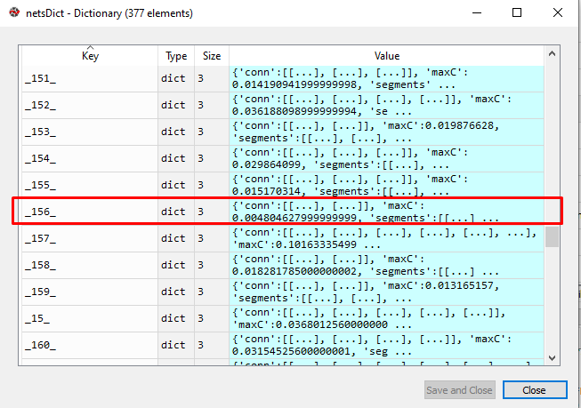
Design - Data Structures (nets dictionary)

Slide 5
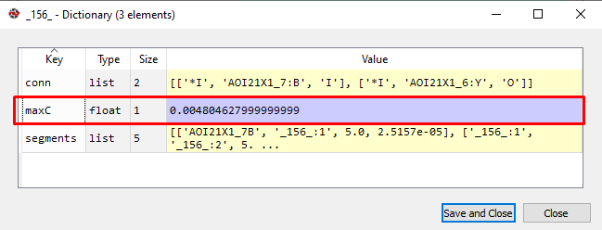
Design - Data Structures (nets dictionary)

Slide 6
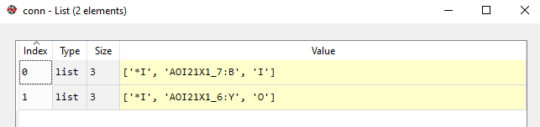
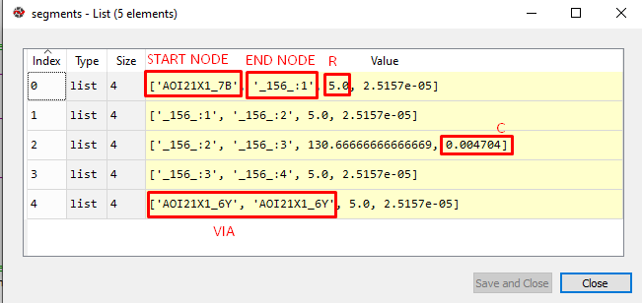
Design - Data Structures(nets dictionary)

Slide 7
Design - Data Structures (nets dictionary)
The previous couple of slides explain the main data structure that was implemented in the project
Simply, a dictionary is used that has 3 sections:
Max capacitance
Connections
Segments
The max capacitance is simply the sum of all the capacitances of the internal nodes within a net
The connection segment mirrors the connection section of the SPEF file that would be printed later
The segment section will be used to create the CAP and RES sections in the SPEF file using the capacitance and resistance of each segment

Slide 8
Design - Data Structures (nets dictionary)
The example show before is for one of the nets: ‘_156_’
This net is totally internal (coming from an internal node and connected to internal nodes)
It has a fanout of 1
The maximum capacitance of parasitics is 0.0048
The segment is structured as follows: [‘startingNode’, ‘endingNode’, resistance, capacitance]
As shown, a segment that has the same node for the starting and ending points represents a via

Slide 9
Algorithms - getPinLocation
This is a function that gets the pin’s location (coordiantes) based on the orientation of the cell (N, S, FS, FN, etc…) and its origin point
Based on those factor, a switch case is implemented to either add, subtract the deltax and deltay (difference to the pin in the N orientation) to the origin point in order to reach the pin’s current coordinates
Finally, it appends this to the table used to store the pins for lookup later

Slide 10
Algorithms - getResistance
This function uses the LEF file and a metal segment to calculate its resistance
It uses the LEF file to access the information about the dimensions of the different metal layers to calculate the resistance
If the starting and ending points have the same coordinates, it treats it as a via and accesses the LEF file to get information regarding the via to calculate the resistance

Slide 11
Algorithms - getCapacitance
This function uses the LEF file and a metal segment to calculate its capacitance (for the end node)
It uses the LEF file to access the information about the dimensions of the different metal layers (C per unit length, EDGECAPACITANCE) to calculate the capacitance
If the starting and ending points have the same coordinates, it treats it as a via and accesses the LEF file to get information regarding the via to calculate the capacitance

Slide 12
Algorithms - checkPinsTable
This function checks if any node intersects with a pin (primary or internal)
It checks the pins table (the table hashing all the pins that have been used before and their coordinates)
If a pin matching this point is not found, a new internal node is defined and it is added to the pinsTable for any further lookup

Slide 13
Algorithm - parsingTheNets
Simply, we go through all the nets in the DEF file
Whenever a net is encountered, its connections are recorded (all the pins the net is connected to) and they are stored in the pinsTable
Then, we go through all the routing section and create as many ‘segments’ as the net needs
Every 2 coordinates would correspond to a metal segment and thus, their capacitance and resistance would be calculated and stored
A via is also considered as a segment (as it has a capacitance and a resistance); however, its starting and ending points would have the same coordinates

Slide 14
Algorithms - printSPEFNets & printNet
This is the function that prints the SPEF file
It takes the nets dictionary and goes through all the nets in it calling the printNet function that goes over the dictionary of each net and prints its information
As mentioned before, each net has 3 sections, maxC, segments and connections
A combination of those sections is used to create the 3 main sections in the SPEF nets: CAP, RES and CON

Slide 15
Major Challenges
Obtaining compatible def and lef files was not easy
Testing was very problematic
We had to learn how to use Docker to be able to run OpenSTA
ICC required .tf files whereas we used .lef files
The liberty file that was used to produce the SPM.v netlist was not compatible with OpenSTA
We had to go to the electronics department to use Cadence in an attempt to produce a timing analysis using the DEF and LEF files (without needing the .tf)
Finally, we had to resort to manual testing for final verification due to the incompatibility of the tools and files with one another (each of them was used separately)
Different LEF/DEF files had different formats making the parsing harder
Understanding the SPEF file was a challenge in the beginning

Slide 16
What needs to be done?
Further testing of the solution (automation) (by 12th)
Finalize the model to be used for the representing each segment (or a group of segment): pi/L/ etc… (by 9th)
Further documentation of the solution (by 14th)
Hash all the nets into a namemap in order to minimize the size of the SPEF file (by 11th)
Consider the case when via is followed by a ; in the def file (by 9th)

Slide 17
Assumptions
+- 5 from a point (to account for the segment width)
Unspecified information regarding the technology is specified to be 0
Each metal segment is represented as a single capacitance and a single resistance

Slide 18
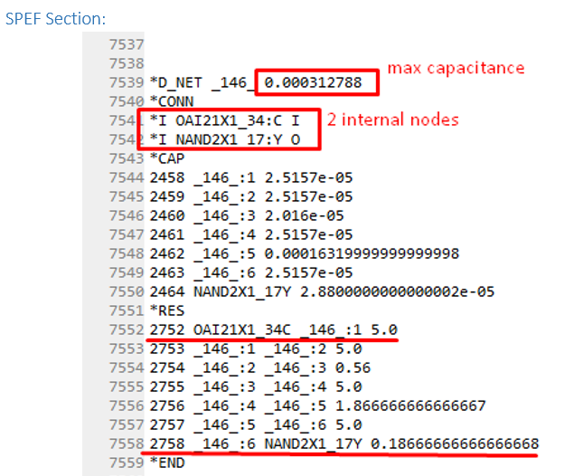
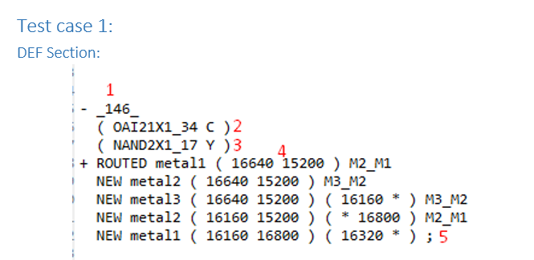
Testcase 1

Slide 19
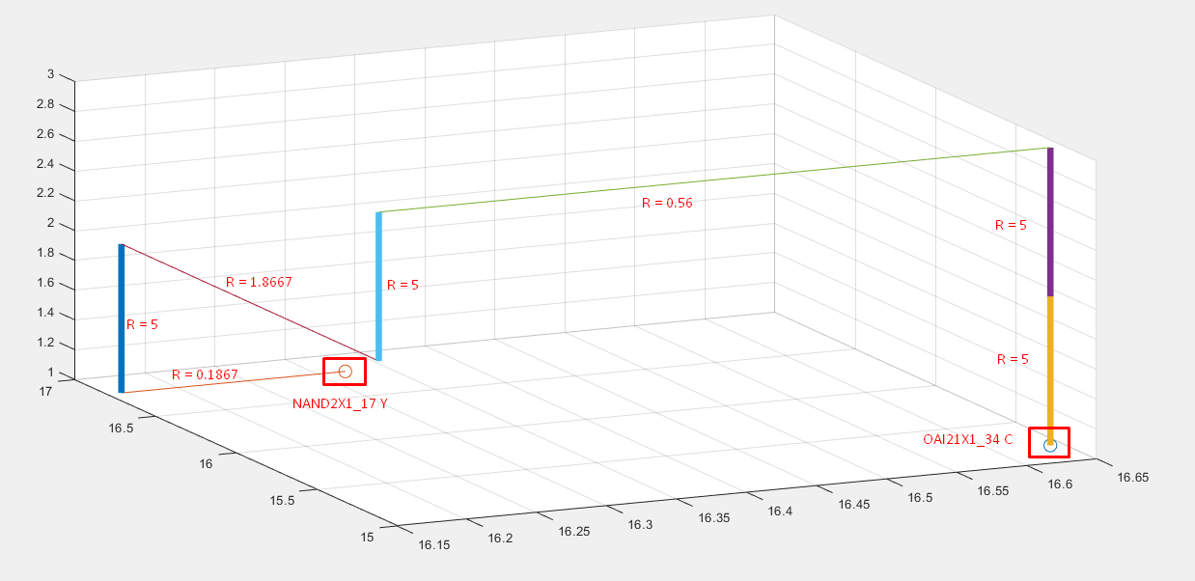

Slide 20
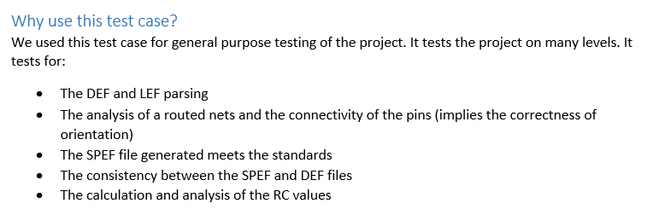
Test case 1 (cont.)

Slide 21
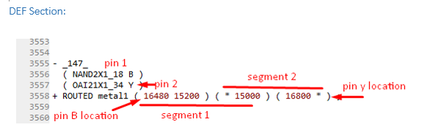
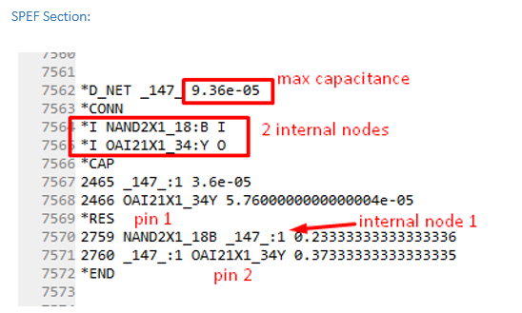
Test case 2

Slide 22
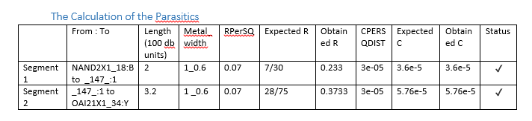
Test case 2
This purpose of this test was to verify that the extraction of the parasitic information from the tech lef file was done correctly

Slide 23
The work of the group members:
Design data structures Ramez / Hany / Samah / Mahfouz
Design the problem solution Ramez / Hany / Samah / Mahfouz
Handle different cell orientations - Ramez
The algorithm for internal nodes hashing and finding - Samah
Obtain via and metal segment capacitance/resistance - Mahfouz
Implement data structures - Hany
Read connections section - Ramez / Mahfouz / Samah
Read nets section - Ramez / Samah / Hany
Printing data structure into a SPEF file - Hany / Samah
Using ICC to produce SPEF and DEF files - Mahfouz / Ramez
Running OpenSTA - Hany
Test cases - Hany

